Slide 1

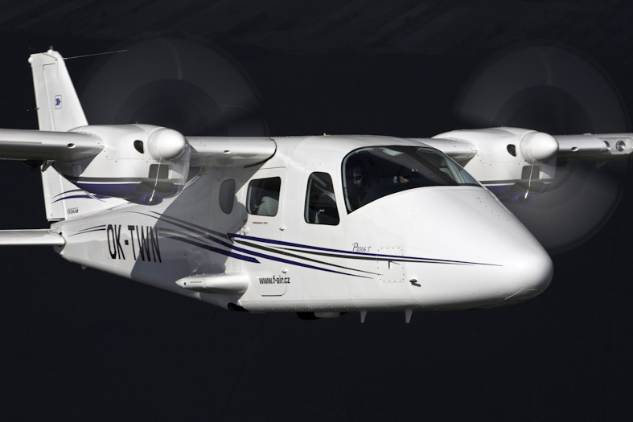
ISO
WWW.TECNAM.NET
9001:2000

Slide 2
OVERVIEW
WWW.TECNAM.NET

Slide 3

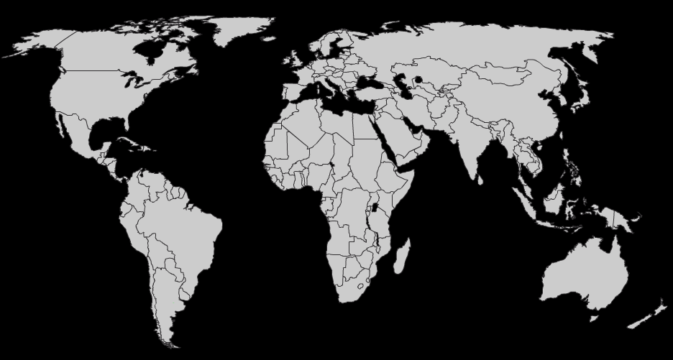
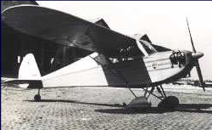
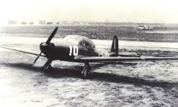
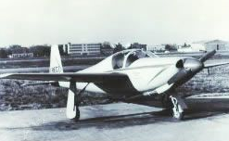
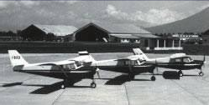
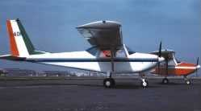
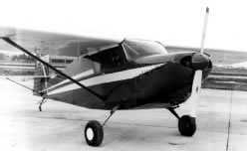
Story
60 Years in Aviation
1948
1952
Two seat tandem aircraft powered by a 65 hp Continental engine.
First aircraft designed and built by Pascale brothers, founders of Partenavia and Tecnam
Three seat aircraft powered by a 100 hp Continental engine. Wooden structure. Retractable tail wheel type landing gear 130 Kts max speed S.L.
P48-B Astore
P52-Tigrotto
1955
1957
Two seat sport aircraft powered by a 150 hp Lycoming engine. All wood monocoque structure. Retractable tricycle type landing gear. Laminar airfoil 190 Kts max speed S.L.
Four seat aircraft powered by a 180 hp Lycoming engine. Wooden-metal structure Tricycle fixed landing gear 135 Kts max speed S.L.
P57 Fachiro
P55-Tornado
1959
1964
Two seat trainer aircraft powered by a 100 hp Continental engine. Wooden-metal structure. Bicycle fixed landing gear 105 Kts max speed S.L.
Winner of the Aero Club Italia Contest for flying schools in 1960
Four seat aircraft powered by 180/200 hp Lycoming engine. Metal structure. Tricycle fixed landing gear. 140 Kts max speed S.L.
P64 Oscar
WWW.TECNAM.NET

Slide 4
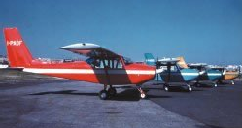
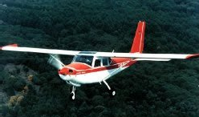
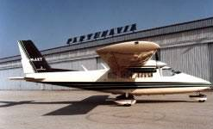
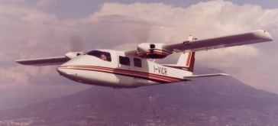
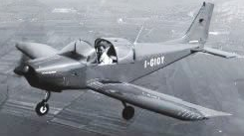
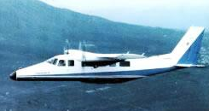
Story:
60 Years in Aviation
1966
1966
Bi/three-seat aircraft powered by 115/150 hp Lycoming engine. Metal structure Tricycle fixed landing gear 125 Kts max speed S.L.
Very popular in the Italian flying clubs
Four-seat aircraft powered by a 160 hp Lycoming engine. Metal structure. Tricycle fixed landing gear 125 Kts max speed S.L.
Selected for the Aero Club Italia flying schools
P66 Oscar 100/150
P66 Charlie
1968
1968
Six-seat twin engine aircraft powered by two 200 hp Lycoming engine. Metal structure. Tricycle fixed landing gear. 172 Kts max speed S.L.
Retractable landing gear version of the P68. Two 200 hp Lycoming engine. 180 Kts max speed S.L.
P68 Victor
The only European light twin engine aircraft sold all over the world
P68 R
1970
Two-seat aircraft powered by a 100 hp Continental engine. Metal structure. Tricycle fixed landing gear 115 Kts max speed S.L.
Ten-seat twin engine turboprop aircraft Two 320 hp Allyson engine. Tricycle retractable landing gear. 200 Kts max speed S.L.
P70 Alfa
AP68 TP Viator
WWW.TECNAM.NET

Slide 5
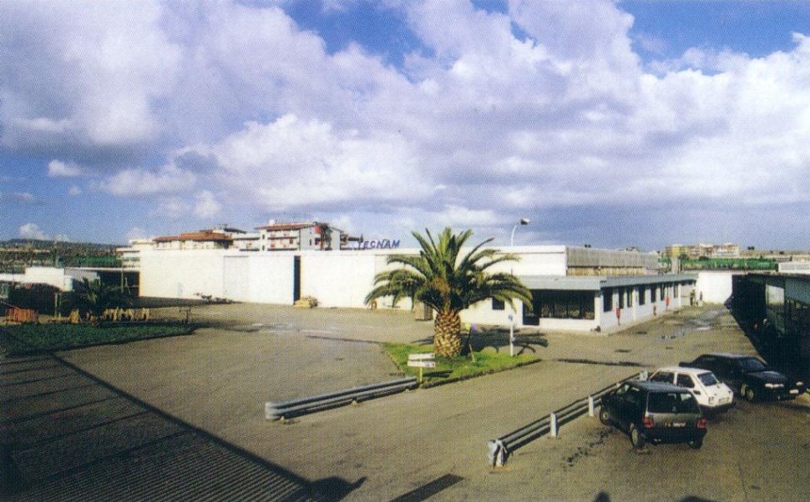
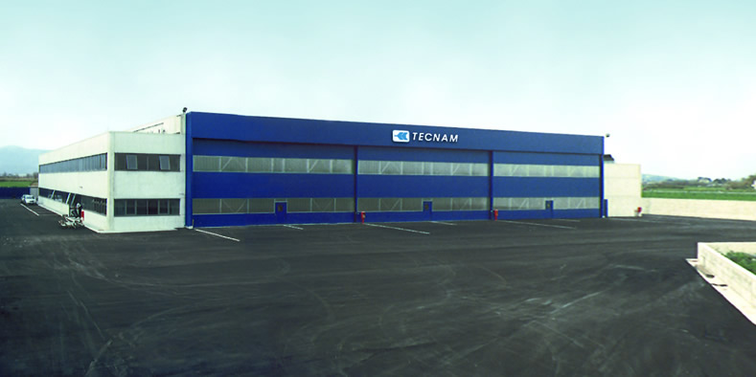
TECNAM Now……
1986
Tecnam has been found
Casoria Plant (11000 m²)
Close to Naples International Airport
2004
Tecnam new Factory
Capua Plant (11200 m²)
Close to Capua General Aviation Airport
WWW.TECNAM.NET

Slide 6
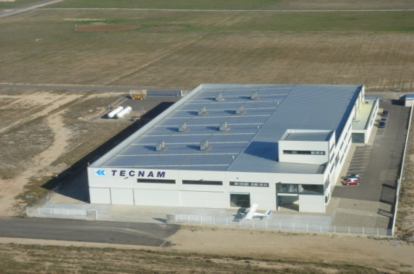
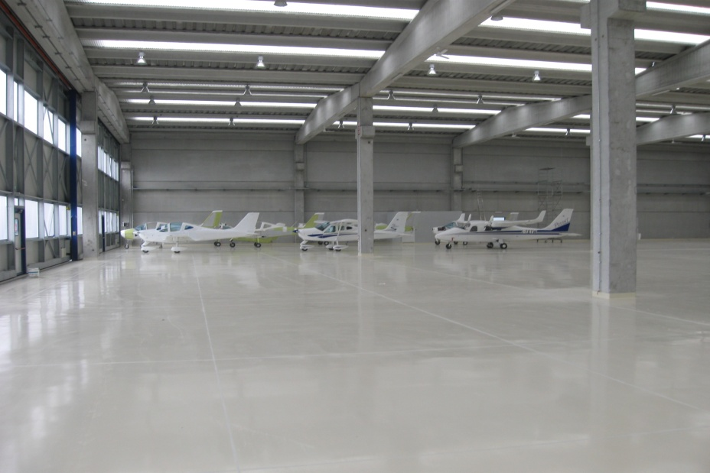
TECNAM Now……
2008
TECNAM Spain
Zaragoza Plant (5000 m²)
RUNWAY 1200 m
2009
Tecnam new Factory
Capua Plant Extension (10000 m²)
Close to Capua General Aviation Airport
WWW.TECNAM.NET

Slide 7
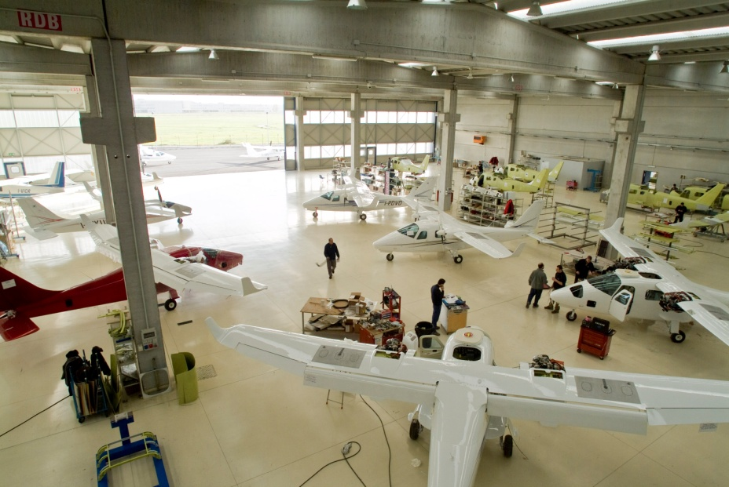
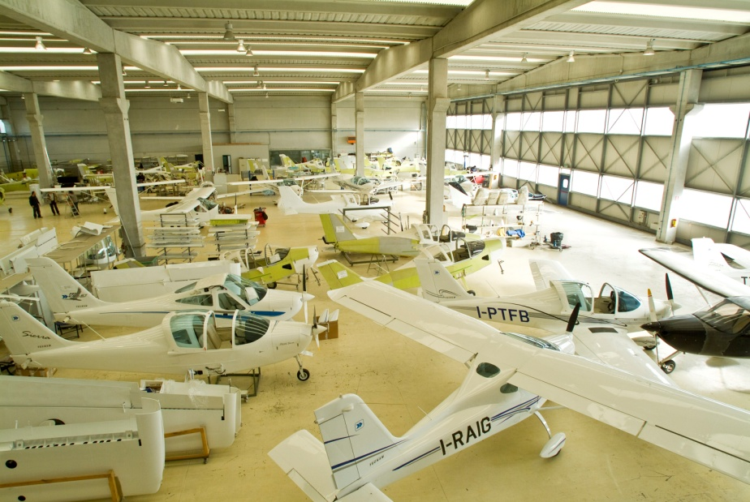
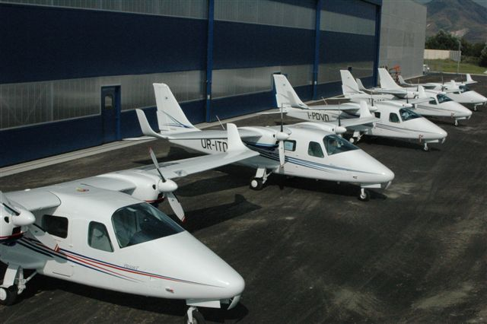
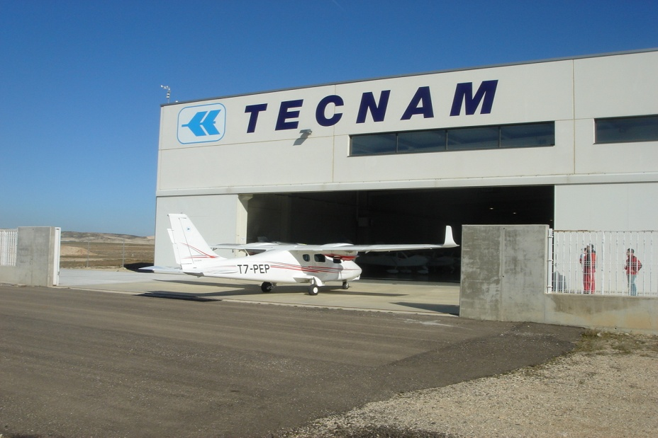
TECNAM Now……
WWW.TECNAM.NET

Slide 8
Description of the Company
TECNAM has a very important history since the Pascale’s brothers started up the spirit of this company sixty years ago;
The experience in the sector is remarkable in front of clients. It makes to this company be leader in Europe and every day is gaining more protagonism to the rest of Continents like America, the Oceania, Asia and Africa;
TECNAM is leader in the segment of light sport aviation since 15 years ago. TECNAM was always oriented to develop this segment around the World;
TECNAM invested many resources, as much human as financiers, to be able to position itself in its segment, because always is offering high quality products accepted;
TECNAM works for their clients to guarantee their fly safety with the best quality.
WWW.TECNAM.NET

Slide 9
PRESIDENT
Luigi Pascale Langer
QUALITY DEPARTMENT
PURCHASE DEPARTMENT
SPART PARTS DEPARTMENT
ACCOUNT DEPARTMENT
DESIGN DEPARTMENT
SALES & MKT DEPARTMENT
CEO
Paolo Pascale Langer
TECNAM
CASORIA
TECNAM
CAPUA
TECNAM
SPAIN
TECNAM Organization
WWW.TECNAM.NET

Slide 10
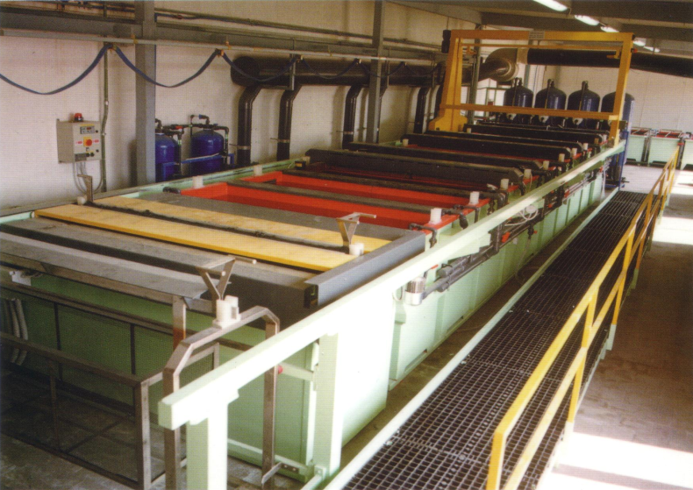
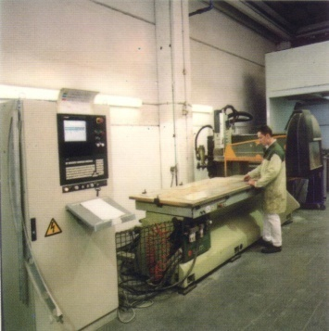
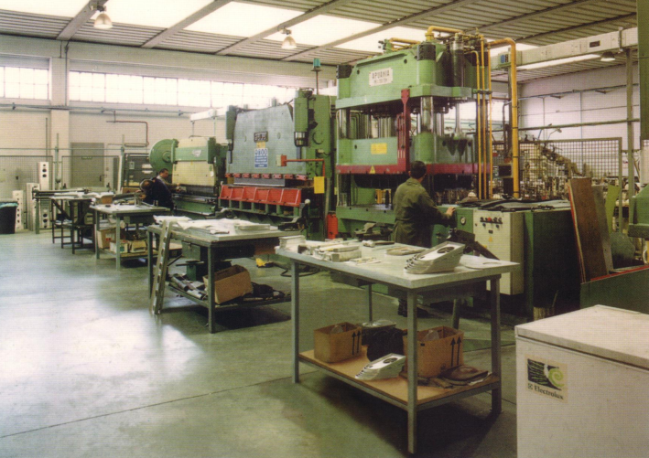
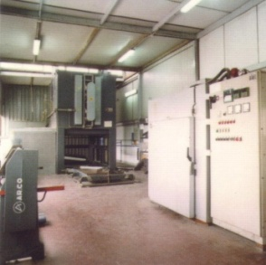
Fully Integrated Manufacturing Capability
Wide Selection of machines and special tools
Tooling fabrication
General machining small-medium size
Jigs fixtures
Precision structural fabrication
Metal sheet forming
Thermal treatment facilities for light alloys
Numerical control machining
Metal welding
Drilling and riveting
Water cutting
ABS forming
WWW.TECNAM.NET

Slide 11
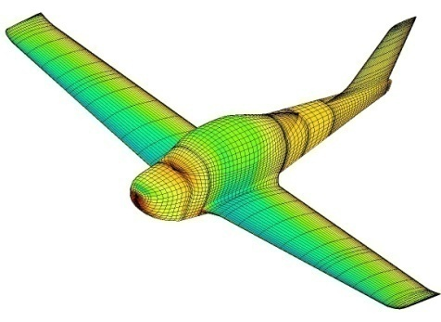
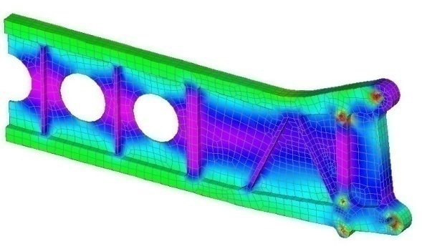
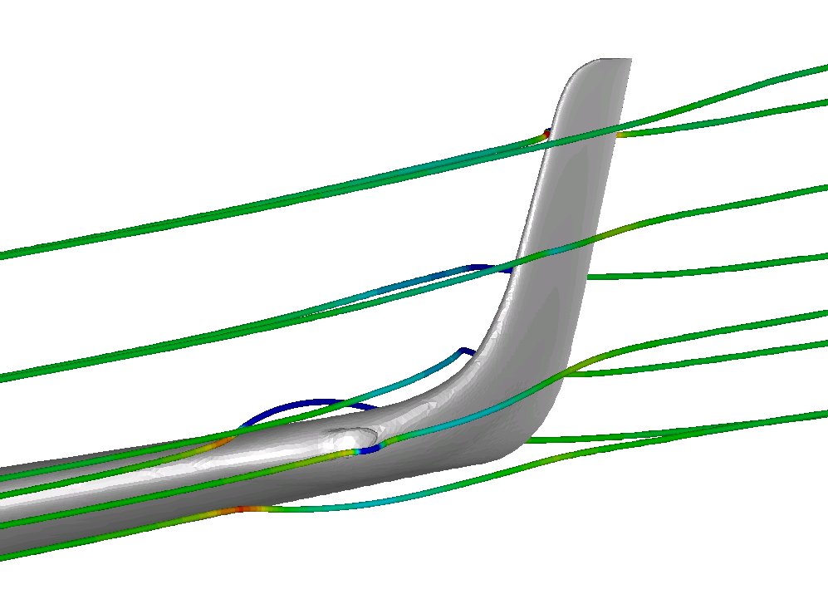
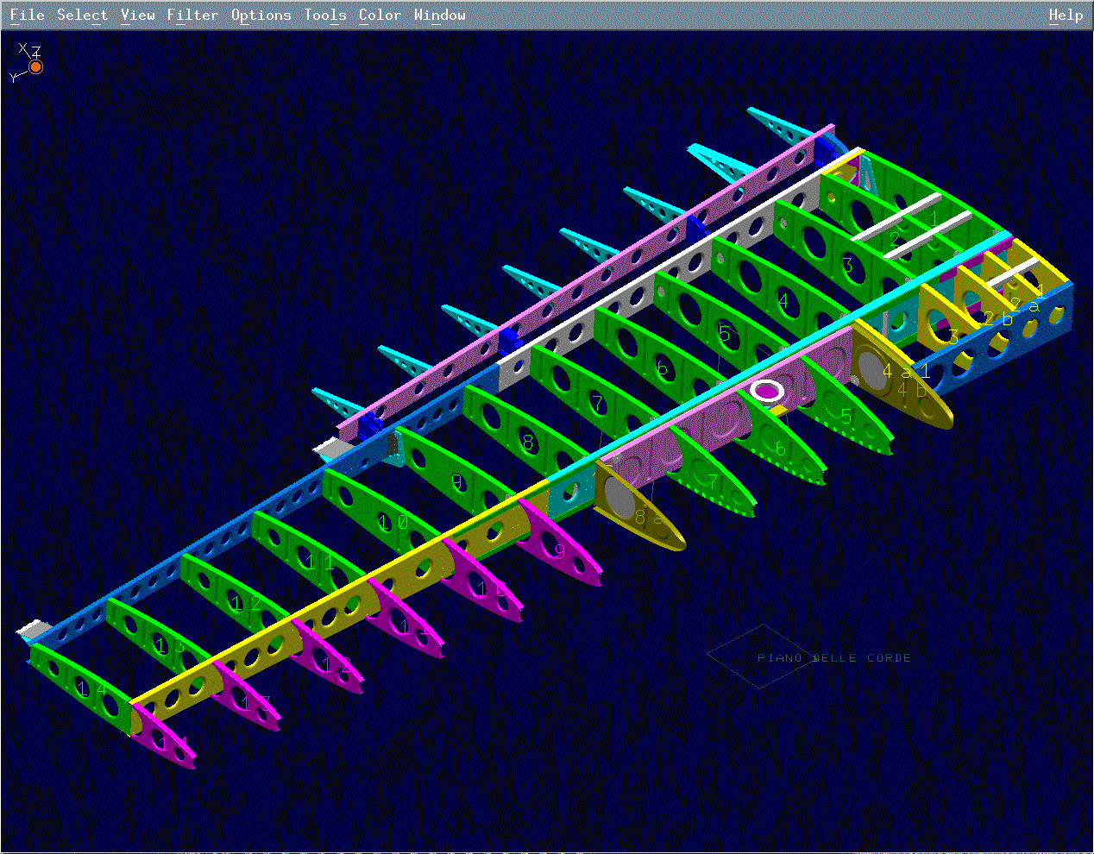
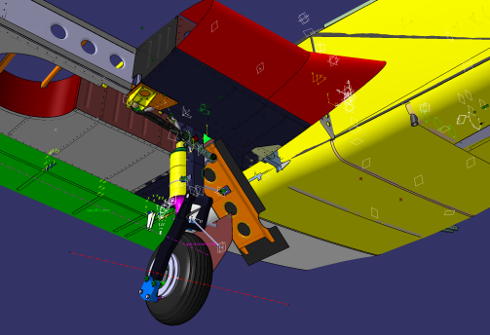
Fully Capability Design Department
State of the Art Software for Analysis and Design
Autocad ©
CATIA© V4 and V5
MSC/Patran©
MSC/Nastran©
FLUENT©
In-house developed software for
Stress analysis, Flight Testing, Performance analysis, Ground Vibration Testing, Aeroelastic Analysis
WWW.TECNAM.NET

Slide 12
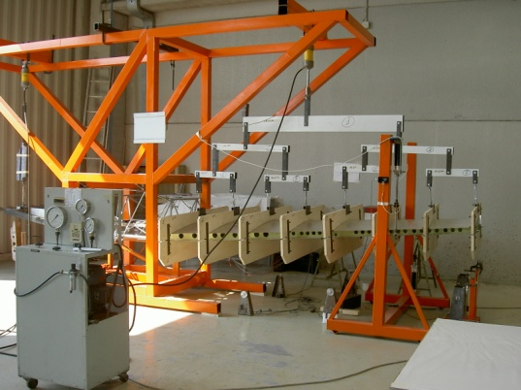
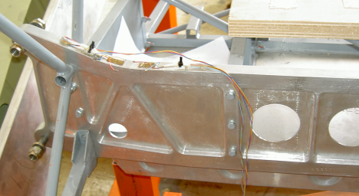
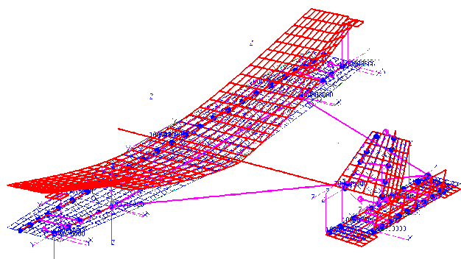
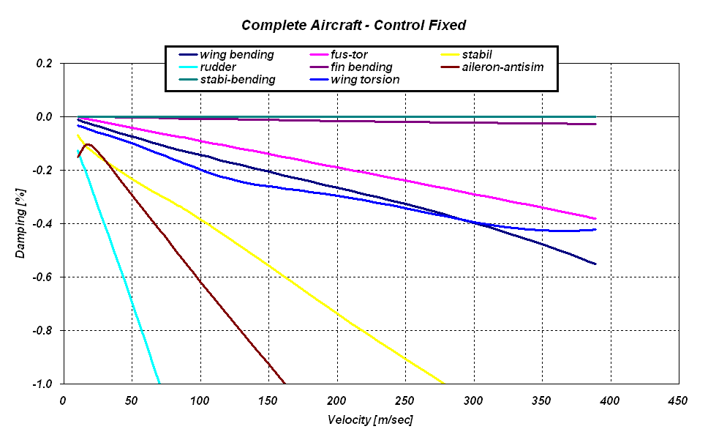
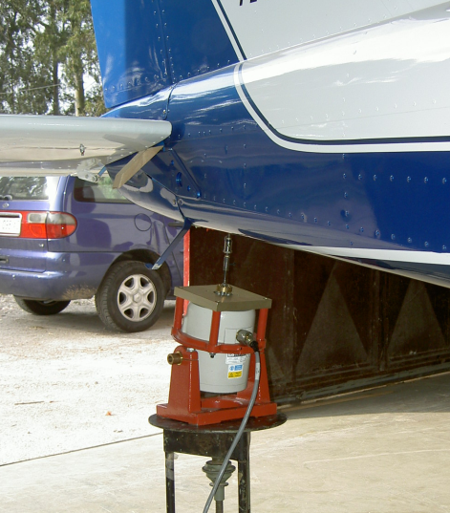
Ground Testing
In house testing of each element of a new aircraft model
no matter if it is a certified model or not
Static testing
Aeroelastic Calculations
Ground Vibration Testing
WWW.TECNAM.NET

Slide 13
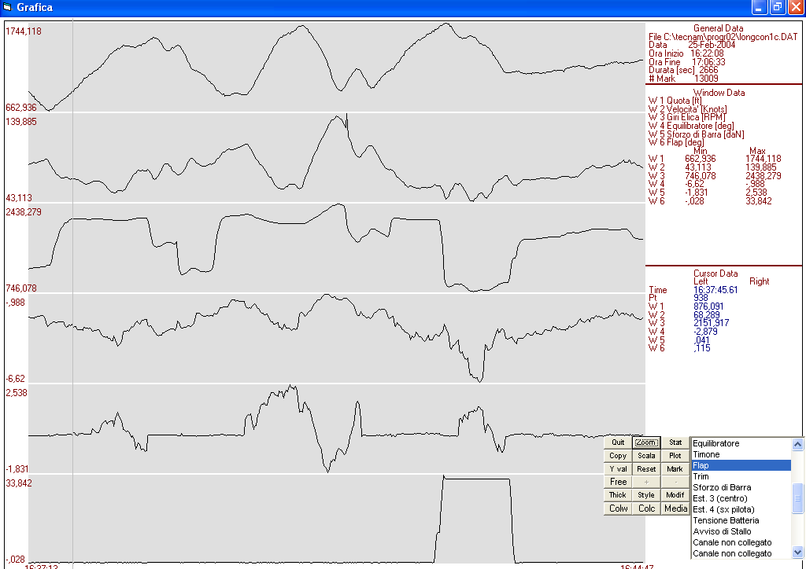
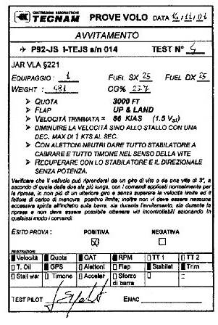
Flight Testing
Aircraft Performance Measurement
Flight Stability and Control
Handling qualities
Flight Path Reconstruction
Noise testing
WWW.TECNAM.NET

Slide 14

Research and Development
Tecnam has always given special attention to R&D activities
The strong link with University of Naples “Federico II” is part of Tecnam history.
Prof. Luigi Pascale has been founder of the Aicraft Design Institute and the Dept. of Aeronautical Engineering.
Additional interactions are with CIRA, Politecnico di Milano, University of Glasgow, TU Delft, DLR, Kansas University.
WWW.TECNAM.NET

Slide 15
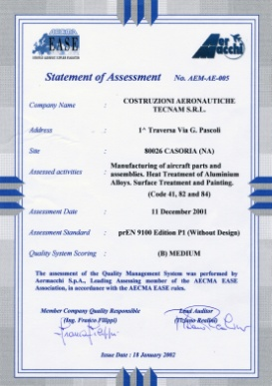
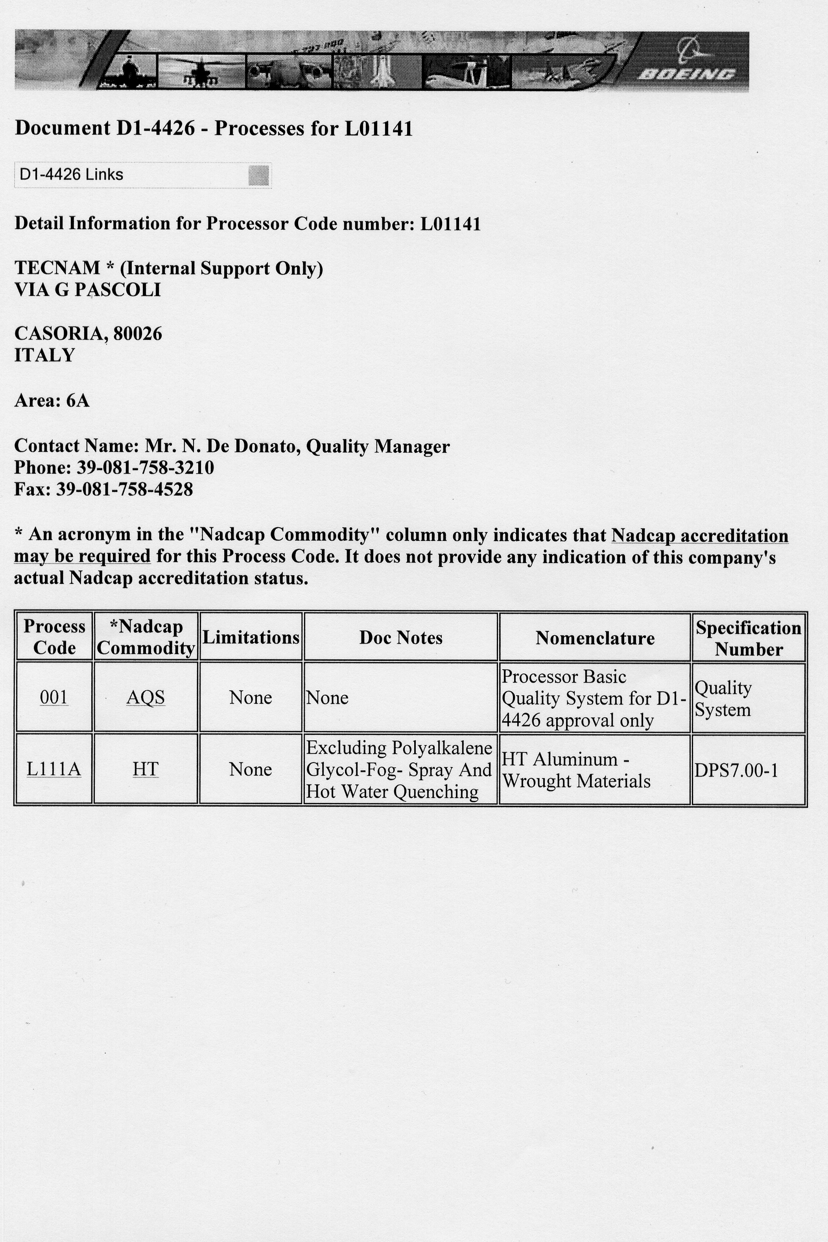
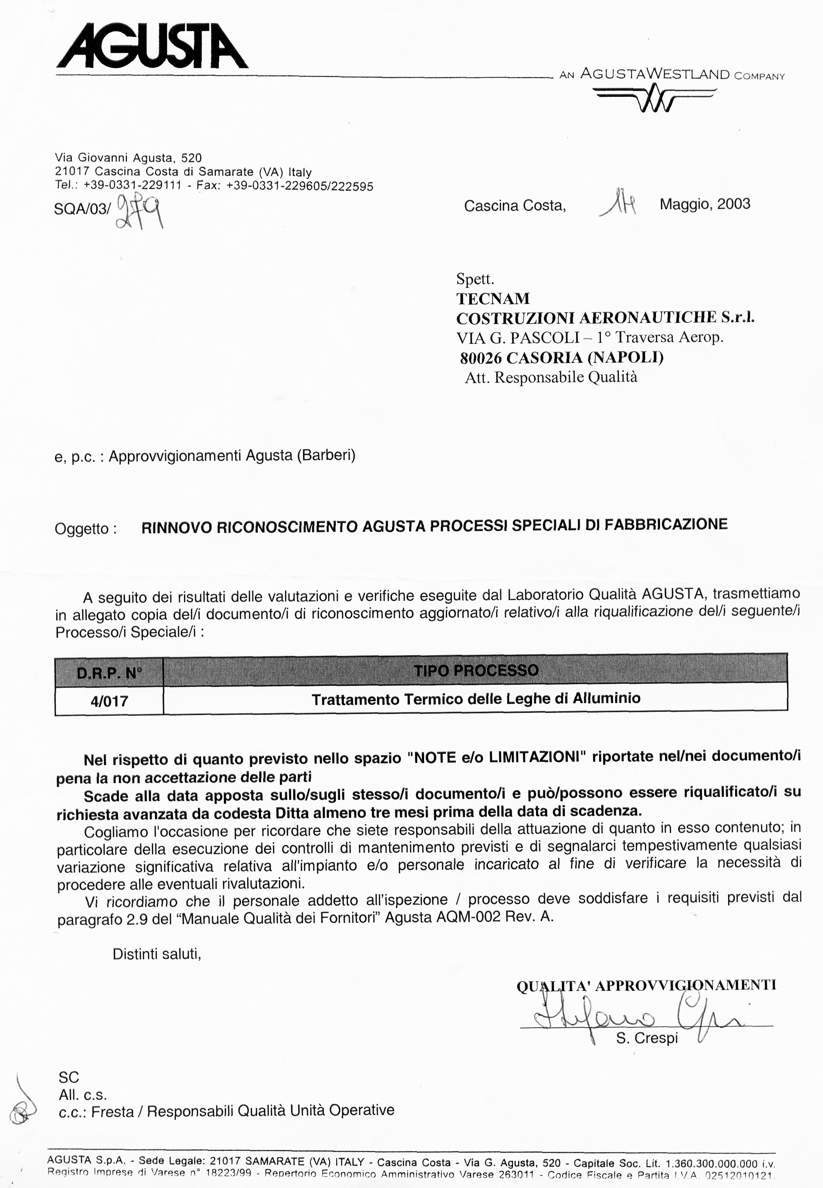
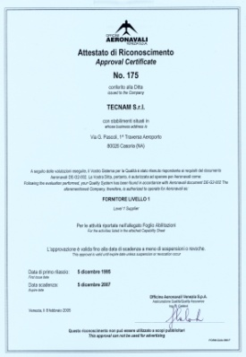
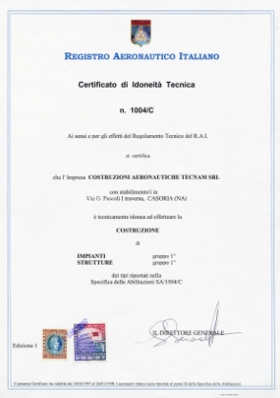
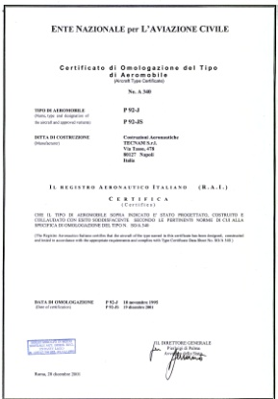
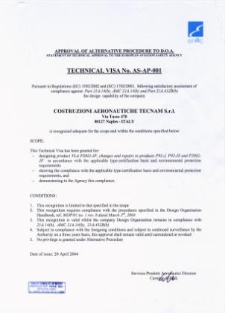
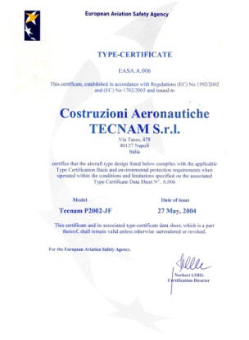
Certifications and Qualifications
TECNAM pays special attention to the Quality level of its Products and Services and to Customer Statisfaction
Statement of Assessment
Statement of Accreditation
Statement of Accreditation
Approval Certificate
RAI/ENAC Production Approval
ENAC Type Certificate
Alternative Procedure to DOA
Technical Approval by EASA
EASA Type Certificate
WWW.TECNAM.NET

Slide 16
TECNAM WORLDWIDE
Australia, New Zealand & Pacific
Lithuania, Estonia, Latvia
Austrian
Malta
Benelux
Mexico
Brazil
Namibia
Bulgaria
Pakistan
Canada
Portugal
Colombia
Republic of Ireland
Czech Republic
Russia
Dominican Republic
Slovenia/Croatia
France
South Africa
Germany
Spain
Indonesia/Malaysia
Sweden
Iran
Switzerland
Israel
United Kingdom
Italy
U.S.A.
WWW.TECNAM.NET

Slide 17
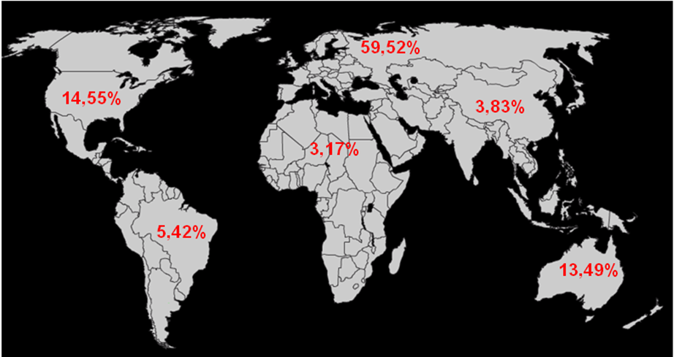
EVOLUTION OF THE SALES IN PERCENTAGE 2006/9
WWW.TECNAM.NET

Slide 18
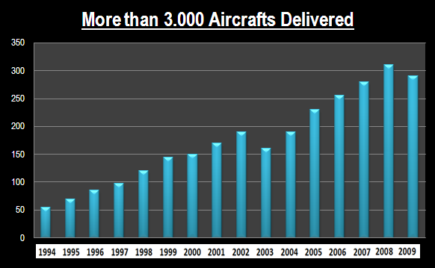
AIRCRAFTS DELIVERED AROUND THE WORLD
WWW.TECNAM.NET

Slide 19
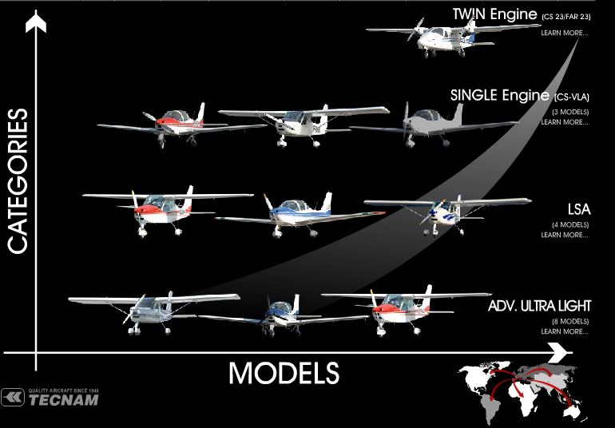
TECNAM AIRCRAFTS
WWW.TECNAM.NET

Slide 20
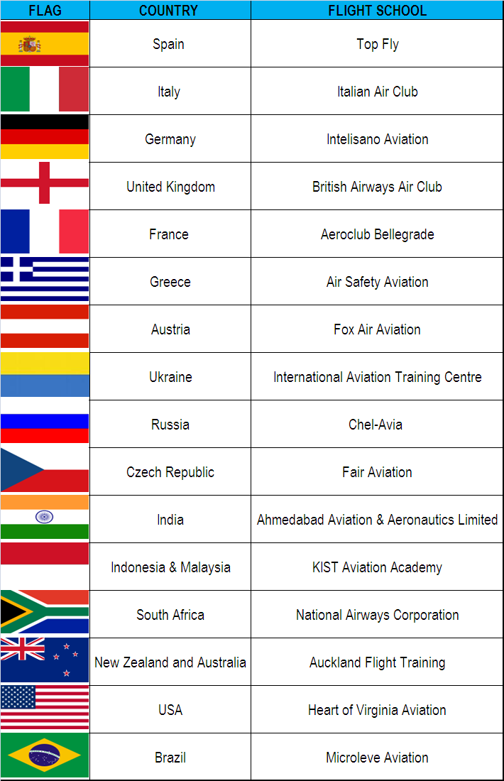
TECNAM DEALERS and FLIGHT SCHOOLS
TECNAM is actually represented in more than 45 countries.
The majority of the Flight Schools are basing their business on TECNAM´s fleet.
WWW.TECNAM.NET

Slide 21

TECNAM GREEN SCHOOL FAMILY
Economy
ECOLOGY
TECNAM is a NEW WAY

Slide 22

TECNAM GREEN SCHOOL FAMILY

Slide 23

TECNAM GREEN SCHOOL FAMILY
LEADER in SPAIN

Slide 24


TECNAM GREEN SCHOOL FAMILY
LEADER in POLAND

Slide 25


TECNAM GREEN SCHOOL FAMILY
LEADER in CZECH

Slide 26

TECNAM GREEN SCHOOL FAMILY
LEADER in RUSSIA

Slide 27

TECNAM GREEN SCHOOL FAMILY
Economy
SAFETY
EXCELENT POWER

Slide 28
DEMONSTRATION FLIGHTS
TODAY - LATE AFTERNOON
ISO
WWW.TECNAM.NET
9001:2000

Slide 29

Thank you…
WWW.TECNAM.NET

