Slide 1
Aviation personnel demand – now and in the future
Forecast for Poland

Slide 2
Plan of the presentation
Need for aviation in the modern world
Actual size of aviation in Poland
Aviation personnel:
3.1 Licensed
- flying personnel
- ground personnel
3.2 Non-licensed
- flying
- postholders on certified organizations
4. Forecast for future

Slide 3
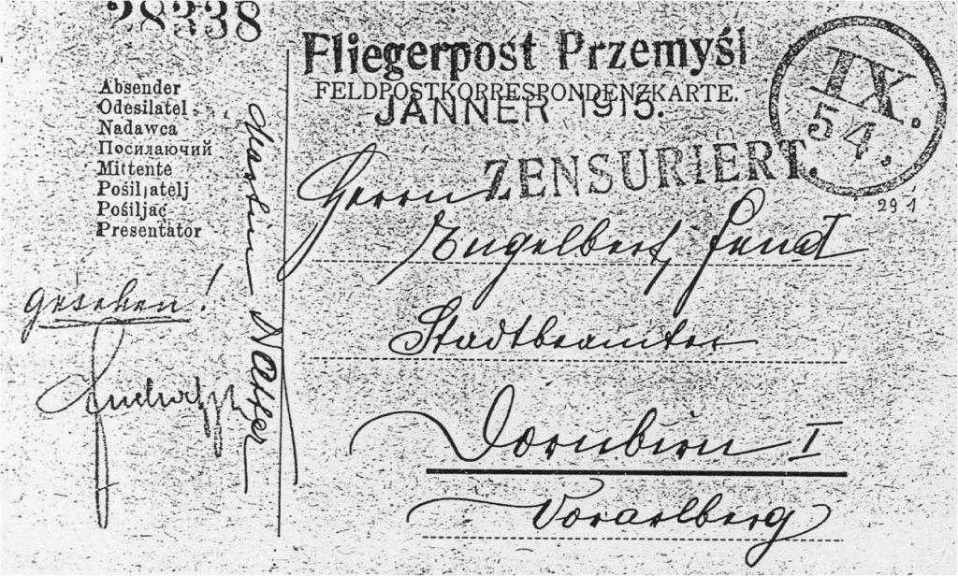
1. Need for aviation in the modern world Air mail in 1915

Slide 4
If travelling - why by plane? Some obvious facts
No other means to reach overseas countries
In specific combination of distance and passenger number aviation is the most environment-friendly transport mode (!)
Time-saving trip is valuable both for buissnes and leisure purposes
GA and sport aviation are perspective occupation of part of the nation
Airports are built quicker than highways and railways

Slide 5
„Green aircraft”- Not so obvious?
For long distance trips aircraft has the lowest possible ground and air friction factor
No need for break and acceleration due to road and traffic changes
Efficiency of modern aircraft (2000km):
- for transport of 1 passenger for 100 km:
An-2: 7,5 kg of fuel
B 737: 2,7 kg
A 380: 2,0 kg
B787/A350: < 2 kg

Slide 6
Polish specific reason for aviation?
Underdeveloped ground infrastructure
Low population density
Growing GDP
EU and Schengen facilitations
Foreign investments
Educated population, open for the world
Great and multigeneration emigration
Open EU labour market
Overseas touristic destinations

Slide 7
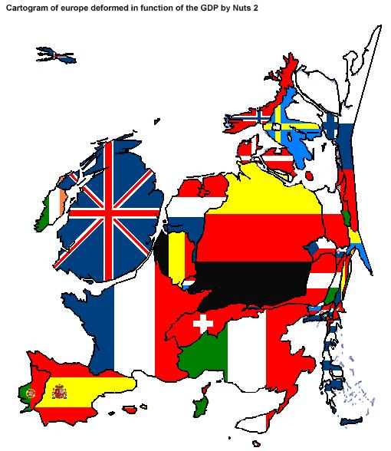

Slide 8
2. Actual size of aviation in Poland - 20 milion of passengers (2010), 38 milion population (0,53 flight per year vs ≈2 in EU15) - 5540 licensed personnel - 2000 aircraft registered - 17 AOC holders - 37 AWC holders - 153 certified aviation schools (!) - 11 airports (only) - DOA and POA - Maintenance and CAMO Passenger number is basic for further considerations

Slide 9
Historic GDP vs PAX number in Polad
Since 1993 GDP growth with sharp rise of PAX

Slide 10
Pax number prediction for Poland (40 mln in 10 years) Polish Civil Aviaton Office prediction done in previous years

Slide 11
Passenger traffic decentralization in Poland since 2004 to 2009 Source: CAO Poland Red – regions Blue – Warsaw The biggest one - 2009

Slide 12
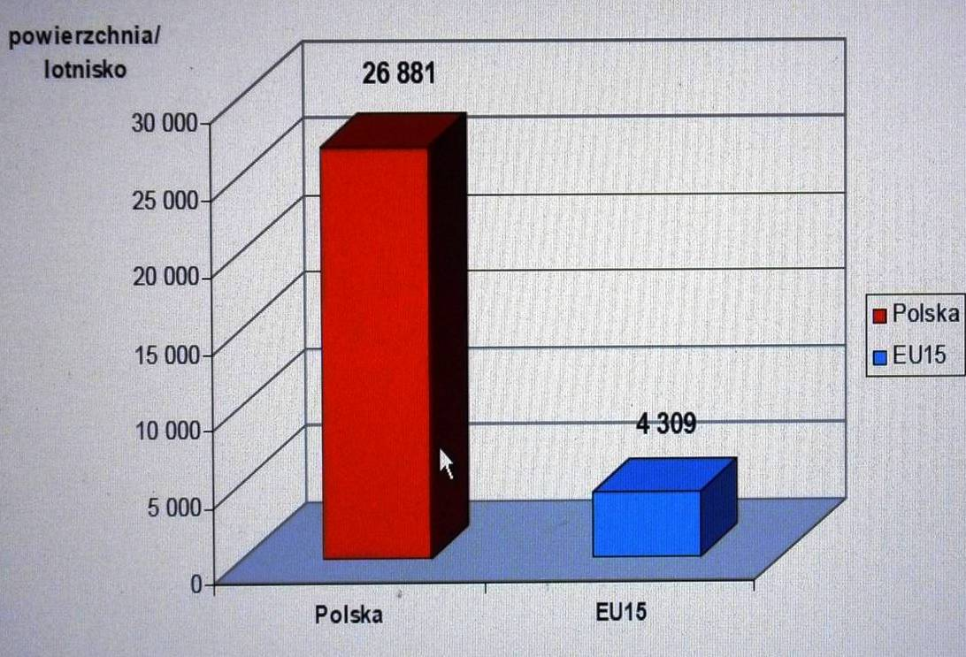
Country area in sq km per airport

Slide 13
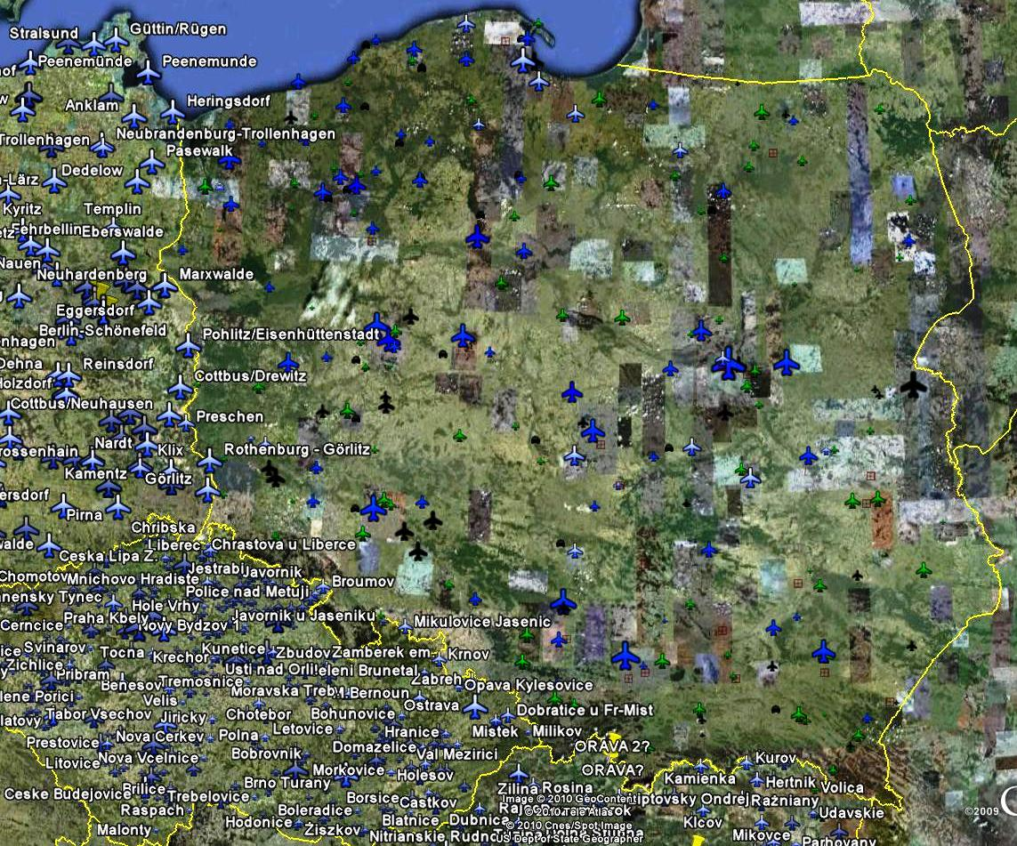

Slide 14
Aviation personnel

Slide 15
3.1 Licensed personnel
Flying personnel
Ground personnel
ATPL
CPL
PPL
LPL
Navigators
Flying mechanics
Mechanics A/B/C
Refueling operators
ATC/FI
Remote controlled vehicles operators

Slide 16
3.2 Approved personnel
Flying personnel
Ground personnel
Cabin attendant
AOC postholders:
- Responsible finance manager (OPS1.175h)
- Postholders: operational, maintenance(OPS1.174i)
Maintenance postholders:
Part M/F:
- Responsible finance manager (AMC M.A.606a)
- Maintenance manager, workshop manager (AMC M.A.606b)
Part 145:
- Responsible finance manager (AMC 145.A.30)
- Responsible managers for hangar, line and workshop (AMC.A.30b)
Training organizations:
- FTO(JAR FCL 1.055a): Trainin man.(HT), Flight man.(CFI), Groung man. (CGI)
- TRTO (JAR FCL1.055 Annex2): Training man. (HT)
- CTO (non-JAR, national):Director, Trainin man.(HT), Flight man.(CFI), Groung man. (CGI), other resposible trainin personnel
Airports: - firefighters, security, meteo,
Security organizations: - screeners
POA
DOA

Slide 17
Licensed personnel age total no of personnel in 2010 = 5450

Slide 18
4. Forecast for future

Slide 19
Approximation for ATPL(A)
In 10 years (2020) 40 mln pax
That is 2,5 mln flights
That is 900 crews, equal to 2500 pilots needed
Now we have 916 ATPL(A) pilots, with 400 non-active after 10 years (500 still active in 2020)
In next 10 years 2000 ATPL pilots must be trained to fulfill demands of Polish market
In 10 years ALL aviation personnel must be doubled!

Slide 20
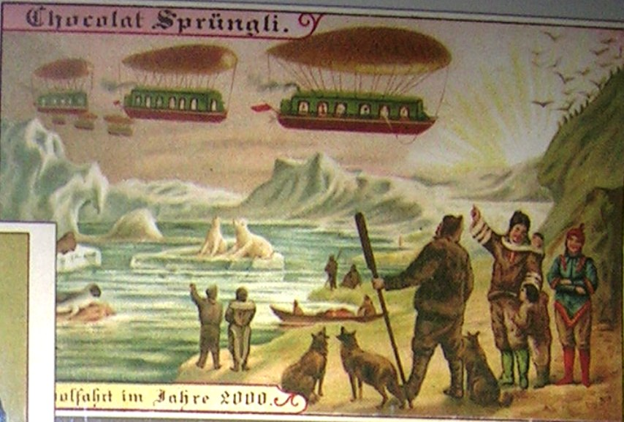
Old prediction of air transport future is only similar to our predictions

Slide 21
Old prediction of General Aviation sometimes distance from predictions to reality is really big…

Slide 22
Recapitulation
GDP growth
Lifestyle
International contacts
Foreign investments
Emigration
- all this creates demand for aviation, firsth of all for air transport, then for training and GA
More flying aircraft
More pilots
More maintenace
More mechanics
More instructors, examiners
More certified organisations (AOC, CAMO, Maintenace, handling, airports, ATC, security, TRTO, DOA, POA etc.)
More postholders
- All this results in education needs to be fullfilled by schools and univerities

Slide 23
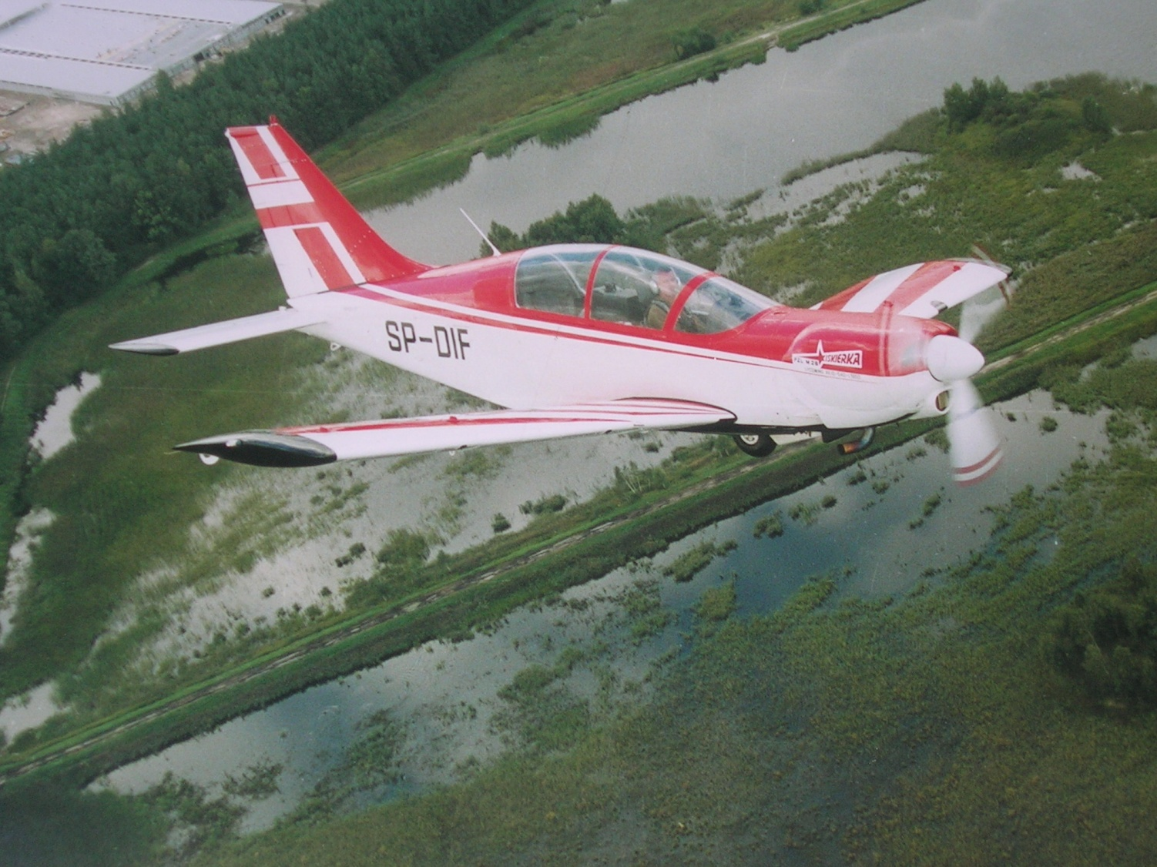
Thank you for your time

