Slide 2
A T P - A e r o J O B T r a i n i n g Program
CANDIDATES PRE-SELECTION
HIGH STANDARDS TRAINING
TRAINING COST FUNDING
CREW RESOURCING SERVICES
A New Way to the Cockpit

Slide 3
A T P - A e r o J O B T r a i n i n g Program
CANDIDATES PRE-SELECTION
A New Way to the Cockpit

Slide 4
A T P - A e r o J O B T r a i n i n g Program
CANDIDATES PRE-SELECTION
MAIN TARGET
To screen and select the best possible candidates out of a large pool of applicants...
...leading to reduced training time and costs by putting only the most capable through training.
A New Way to the Cockpit

Slide 5
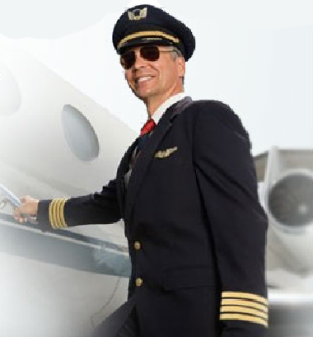
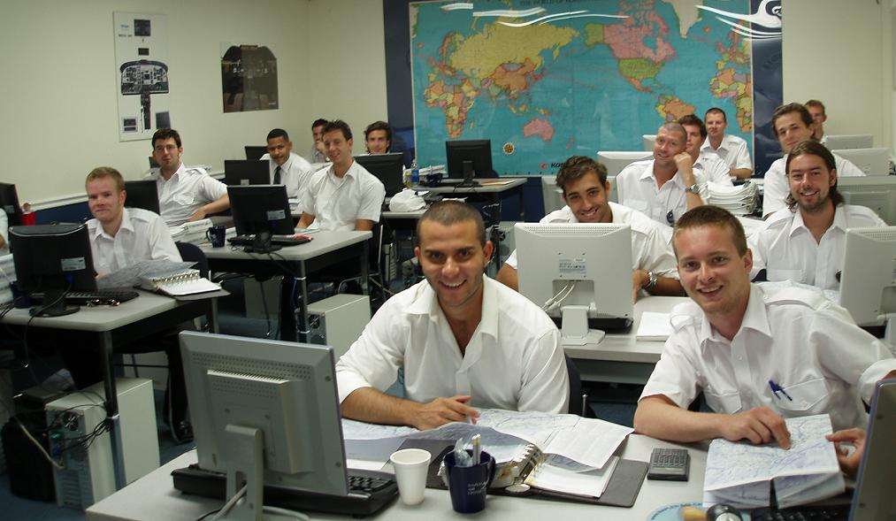
A T P - A e r o J O B T r a i n i n g Program
CANDIDATES PRE-SELECTION
HOW TO REACH THE TARGET ?
Modern PC testing methods
Precise, objective and independent evaluation
Highly educated & experienced examiners in the
fields of psychology & professional aviation
A New Way to the Cockpit

Slide 6
A T P - A e r o J O B T r a i n i n g Program
CANDIDATES PRE-SELECTION
FOUR MODULES
1 - TECHNICAL KNOWLEDGE: oral, written & PC testing
2 - COMPASS: computer based evaluation
3 - ENGLISH: tests / interview
4 - PSYCHOLOGY: PC based initial evaluation, followed by group
exercises & individual evaluations by our staff psychologist
A New Way to the Cockpit

Slide 7
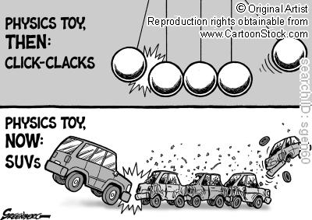
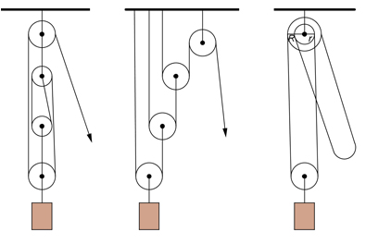
A T P - A e r o J O B T r a i n i n g Program
CANDIDATES PRE-SELECTION
A New Way to the Cockpit

Slide 8
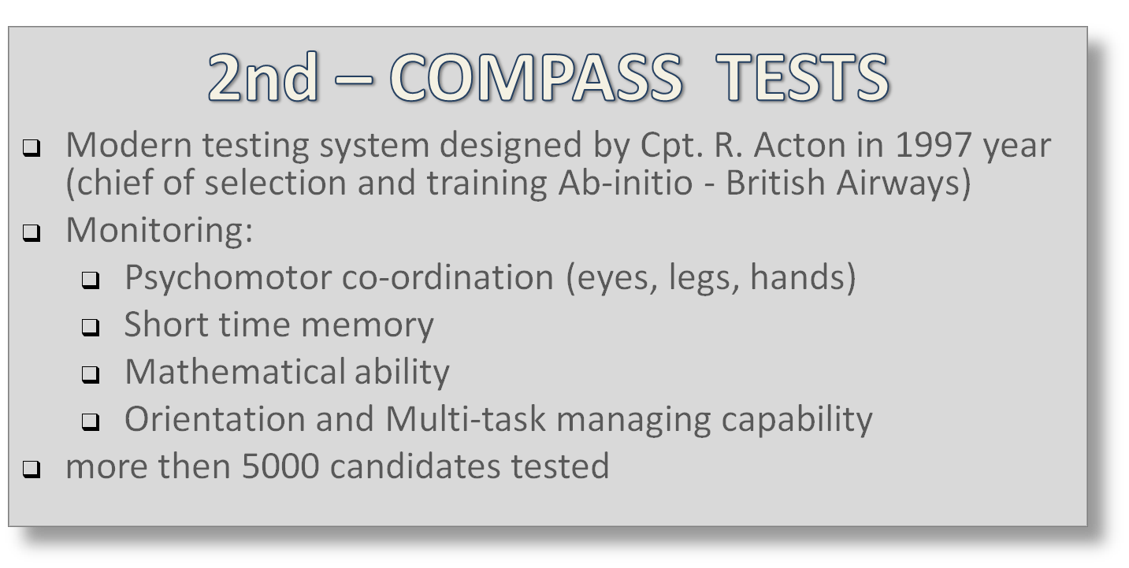
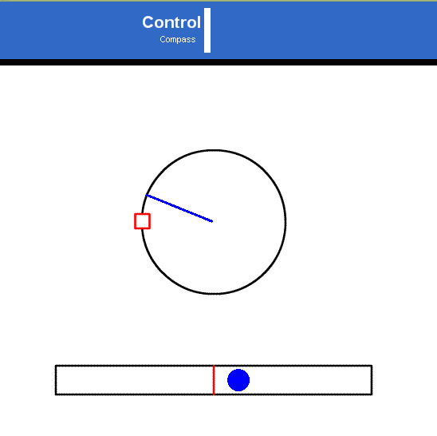
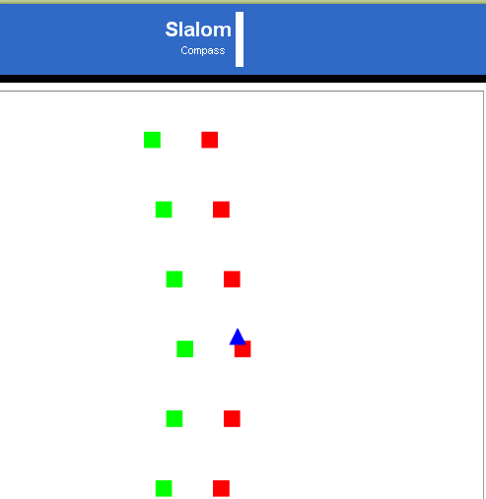
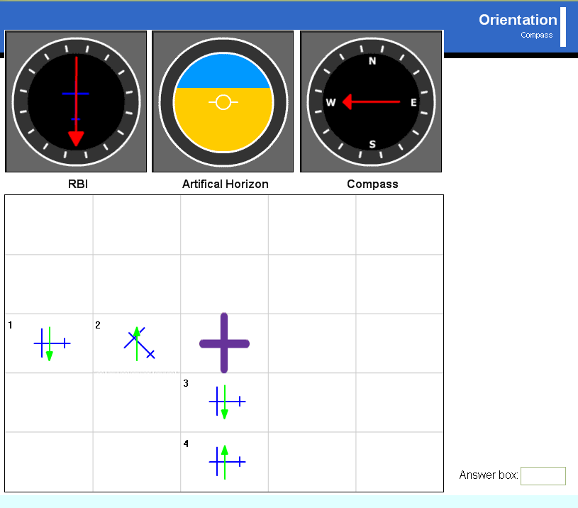
A T P - A e r o J O B T r a i n i n g Program
CANDIDATES PRE-SELECTION
A New Way to the Cockpit

Slide 9
A T P - A e r o J O B T r a i n i n g Program
CANDIDATES PRE-SELECTION
A New Way to the Cockpit

Slide 10
A T P - A e r o J O B T r a i n i n g Program
CANDIDATES PRE-SELECTION
A New Way to the Cockpit

Slide 11
A T P - A e r o J O B T r a i n i n g Program
CANDIDATES PRE-SELECTION
A New Way to the Cockpit

Slide 12
A T P - A e r o J O B T r a i n i n g Program
HIGH STANDARDS TRAINING
A New Way to the Cockpit

Slide 13
A T P - A e r o J O B T r a i n i n g Program
HIGH STANDARDS TRAINING
MAIN TARGET
To provide the best quality pilot training
A New Way to the Cockpit

Slide 14
A T P - A e r o J O B T r a i n i n g Program
HIGH STANDARDS TRAINING
MAIN ATP FEATURES
Modern learning methods
Special training program
Experienced instructors and lectors
Modern, well equipped aircraft and simulators
Continuous testing and progress checking
A New Way to the Cockpit

Slide 15
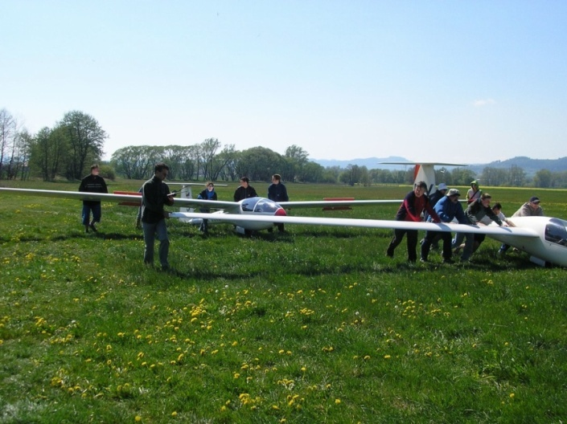
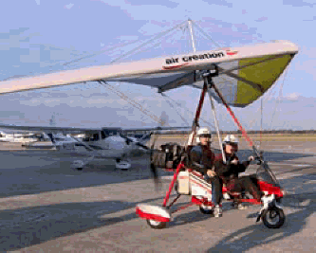
A T P - A e r o J O B T r a i n i n g Program
HIGH STANDARDS TRAINING
HOW TO REACH THE ATPL TRAINING?
Aeroclub?
A New Way to the Cockpit

Slide 16
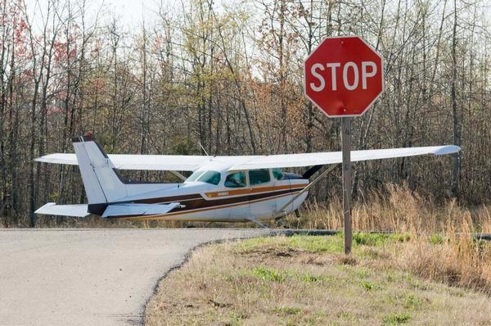
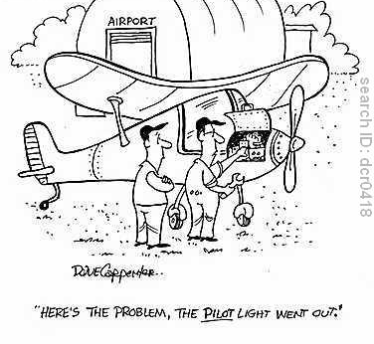
A T P - A e r o J O B T r a i n i n g Program
HIGH STANDARDS TRAINING
HOW TO REACH THE ATPL TRAINING?
Uncontrolled basic training?
A New Way to the Cockpit

Slide 17
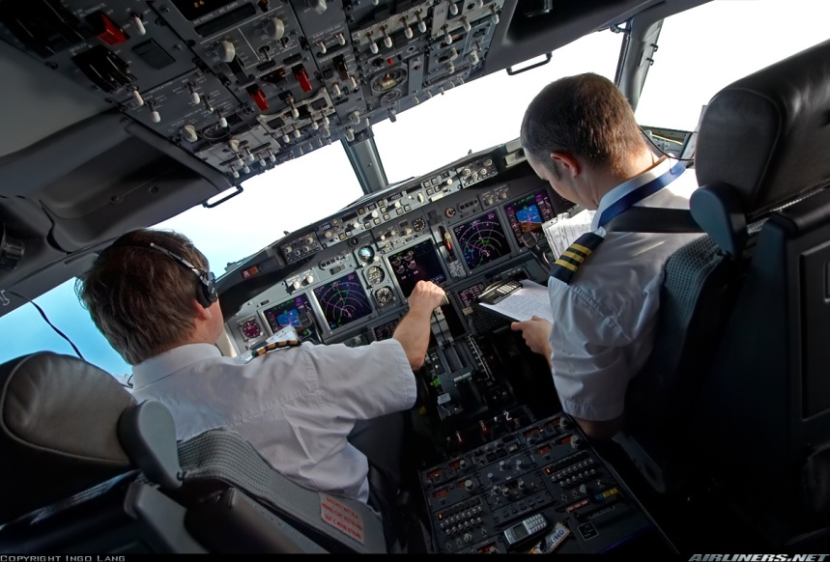
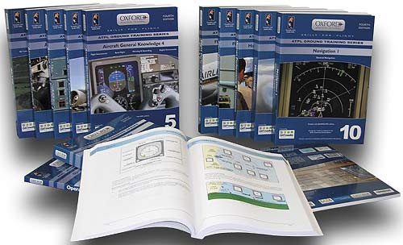
A T P - A e r o J O B T r a i n i n g Program
HIGH STANDARDS TRAINING
HOW TO REACH THE ATPL TRAINING?
...or controlled ATPL training?
A New Way to the Cockpit

Slide 18
A T P - A e r o J O B T r a i n i n g Program
HIGH STANDARDS TRAINING
AeroJOB TRAINING PROGRAM
A New Way to the Cockpit

Slide 19
A T P - A e r o J O B T r a i n i n g Program
HIGH STANDARDS TRAINING
BASIC ATPL TRAINING
PPL
NIGHT
IR
MEP
CPL
A New Way to the Cockpit

Slide 20
A T P - A e r o J O B T r a i n i n g Program
HIGH STANDARDS TRAINING
BASIC ATPL TRAINING
PPL
PIC
CC
NIGHT
IR
MEP
CPL
PIC
A New Way to the Cockpit

Slide 21
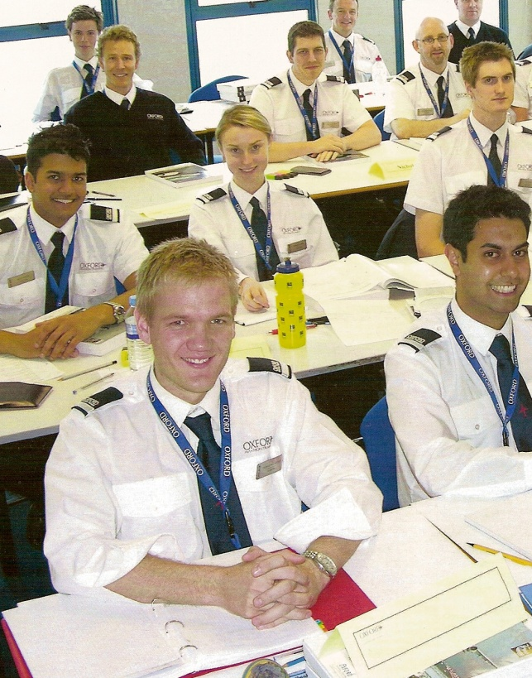
A T P - A e r o J O B T r a i n i n g Program
HIGH STANDARDS TRAINING
BASIC ATPL TRAINING
ATP - ADDITIONAL GROUND LESSONS
PPL
PIC
CC
NIGHT
IR
MEP
CPL
PIC
WE GUARANTEE ICAO Level 5
- Native speakers as lectors
- Additional English improvement course
ATP - ADDITIONAL TESTING + PROGRESS CHECKING
A New Way to the Cockpit

Slide 22
A T P - A e r o J O B T r a i n i n g Program
HIGH STANDARDS TRAINING
BASIC ATPL TRAINING
RESULT
VERY BEST QUALITY PILOTS
ATP - ADDITIONAL GROUND LESSONS
PPL
PIC
CC
NIGHT
IR
MEP
CPL
PIC
ATP - ADDITIONAL TESTING + PROGRESS CHECKING
A New Way to the Cockpit

Slide 23
A T P - A e r o J O B T r a i n i n g Program
HIGH STANDARDS TRAINING
BASIC ATPL TRAINING
Practical courses provided by the
pilot training leaders in Central Europe
A New Way to the Cockpit

Slide 24
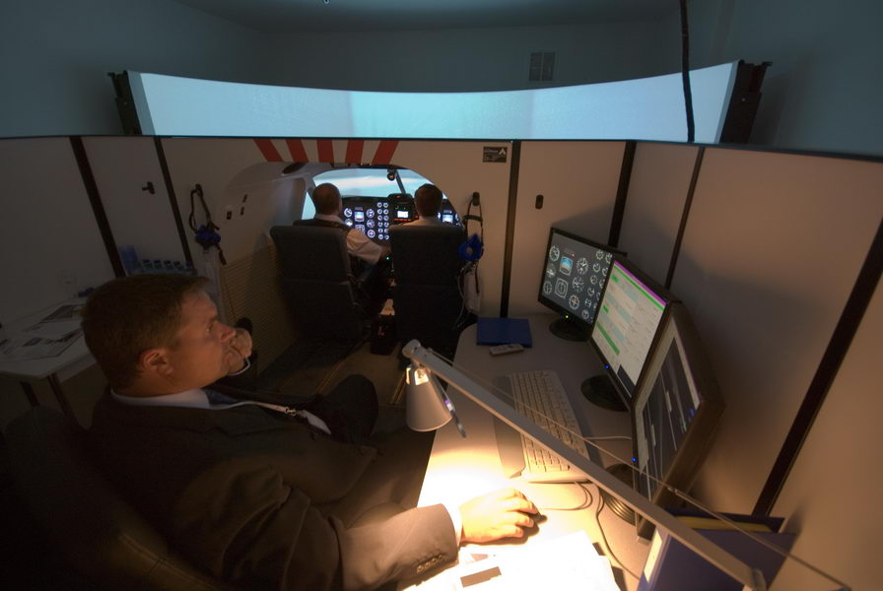
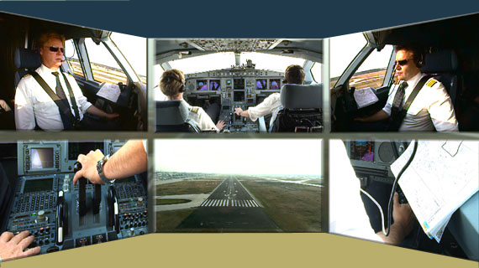
A T P - A e r o J O B T r a i n i n g Program
HIGH STANDARDS TRAINING
HIGH STANDARDS TRAINING
MCC – Multi-Crew Cooperation
Highly experienced instructors
Advanced flight simulator
Approach to airline standards and procedures
A New Way to the Cockpit

Slide 25
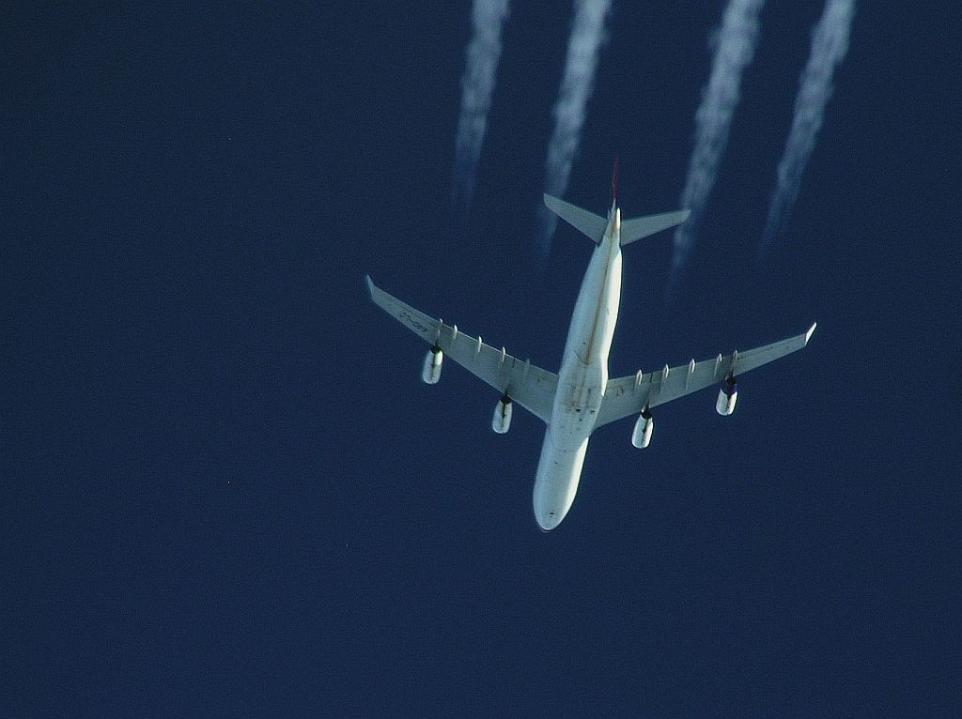
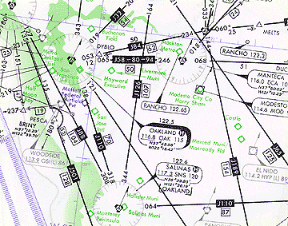
A T P - A e r o J O B T r a i n i n g Program
HIGH STANDARDS TRAINING
JOC – Jet Orientation Course
High Performances Aircaft Operation
High Level En-Route Flying
Type Rating Preparation
A New Way to the Cockpit

Slide 26
A T P - A e r o J O B T r a i n i n g Program
HIGH STANDARDS TRAINING
TYPE RATING
Type Specific Training
provided by well known European TRTOs
FSC, Netherlands
RWL, Germany
IFTC, Turkey
A New Way to the Cockpit

Slide 27
A T P - A e r o J O B T r a i n i n g Program
HIGH STANDARDS TRAINING
TYPE RATING
Final Step in Preparation for
the Airline Cockpit
A New Way to the Cockpit

Slide 28
A T P - A e r o J O B T r a i n i n g Program
Additional Flight Lesson
VMC Upset Recovery
IMC Upset Recovery
IMC Upset Recovery

Slide 29
A T P - A e r o J O B T r a i n i n g Program
Course Features | Course Outline
Objective: Familiarizes students with procedures and techniques to recover an aircraft from upset situations Course Length: Less than One day Course Delivery Instructor-led simulator session that includes a briefing – 1 hour briefing – 1 hour simulator session | Introduction to upset recovery Large airplanes aerodynamics characteristics Energy Management - pitch control, lateral, directional control Recovery techniques - factors Pitch-up scenarios performed Rollover scenarios performed Procedures
Course Creation Team
Provided by Johnny Mann
Marketing Analyst
BOEING
A New Way to the Cockpit

Slide 30
A T P - A e r o J O B T r a i n i n g Program
Additional Training - CRM
CRM
CRM
CRM
A New Way to the Cockpit

Slide 31
A T P - A e r o J O B T r a i n i n g Program
SOP Implementation
SOP
SOP
SOP
A New Way to the Cockpit

Slide 32
A T P - A e r o J O B T r a i n i n g Program
TRAINING COST FUNDING
A New Way to the Cockpit

Slide 33
A T P - A e r o J O B T r a i n i n g Program
TRAINING COST FUNDING
UNIQUE BANK FUNDING
10 year credit
Low annual interest rate
Up to 1.500.000,- CZK
Czech Republic
A New Way to the Cockpit

Slide 34
A T P - A e r o J O B T r a i n i n g Program
TRAINING COST FUNDING
BANK FUNDING PARTNERSHIP
IN CZECH REPUBLIC
A New Way to the Cockpit

Slide 35
A T P - A e r o J O B T r a i n i n g Program
TRAINING COST FUNDING
UNIQUE BANK FUNDING
10 year credit
Low annual interest rate
Up to 50000,- EUR
Slovak Republic
A New Way to the Cockpit

Slide 36
A T P - A e r o J O B T r a i n i n g Program
TRAINING COST FUNDING
BANK FUNDING PARTNERSHIP
IN SLOVAK REPUBLIC
A New Way to the Cockpit

Slide 37
A T P - A e r o J O B T r a i n i n g Program
TRAINING COST FUNDING
NUMBER OF FUNDING FROM 2008
27
TOTAL IN CZK
24.550.865,-
A New Way to the Cockpit

Slide 38
A T P - A e r o J O B T r a i n i n g Program
CREW RESOURCING SERVICES
A New Way to the Cockpit

Slide 39
A T P - A e r o J O B T r a i n i n g Program
CREW RESOURCING SERVICES
A New Way to the Cockpit

Slide 40
A T P - A e r o J O B T r a i n i n g Program
CREW RESOURCING SERVICES
A New Way to the Cockpit

Slide 41
A T P - A e r o J O B T r a i n i n g Program
CREW RESOURCING SERVICES
CONTRACTED PARTNERS
A New Way to the Cockpit

Slide 42
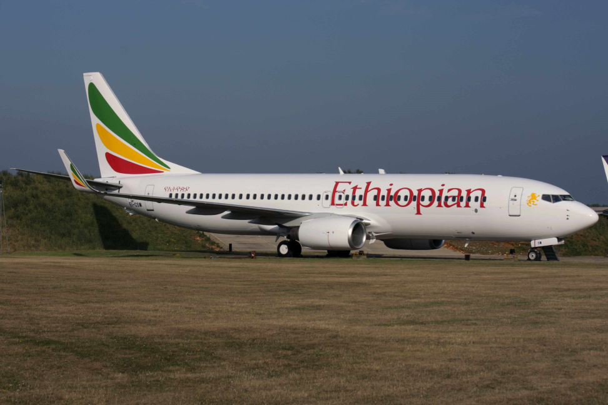
A T P - A e r o J O B T r a i n i n g Program
CREW RESOURCING SERVICES
CONTRACTED PARTNERS
A New Way to the Cockpit

Slide 43
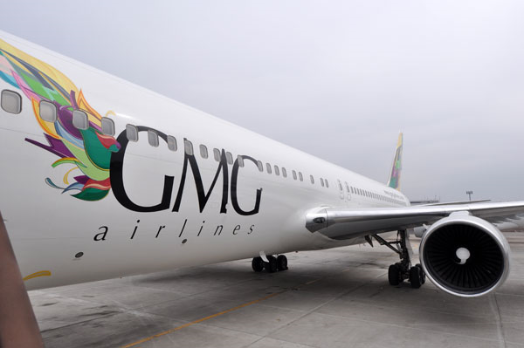
A T P - A e r o J O B T r a i n i n g Program
CREW RESOURCING SERVICES
CONTRACTED PARTNERS
A New Way to the Cockpit

Slide 44
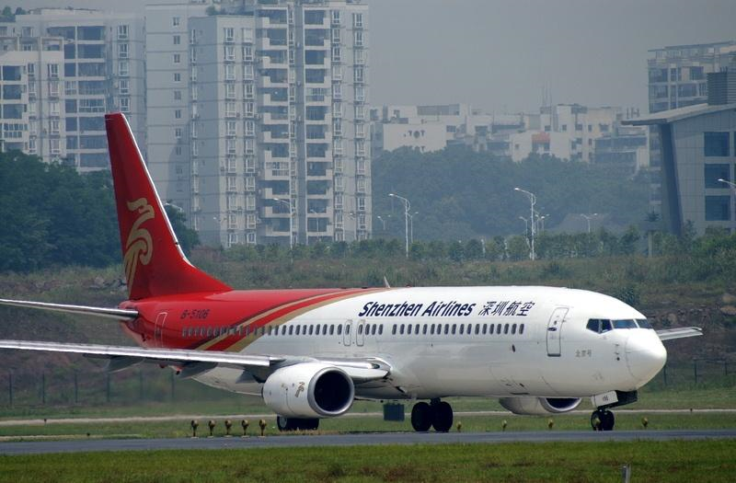
A T P - A e r o J O B T r a i n i n g Program
CREW RESOURCING SERVICES
CONTRACTED PARTNERS
A New Way to the Cockpit

Slide 45
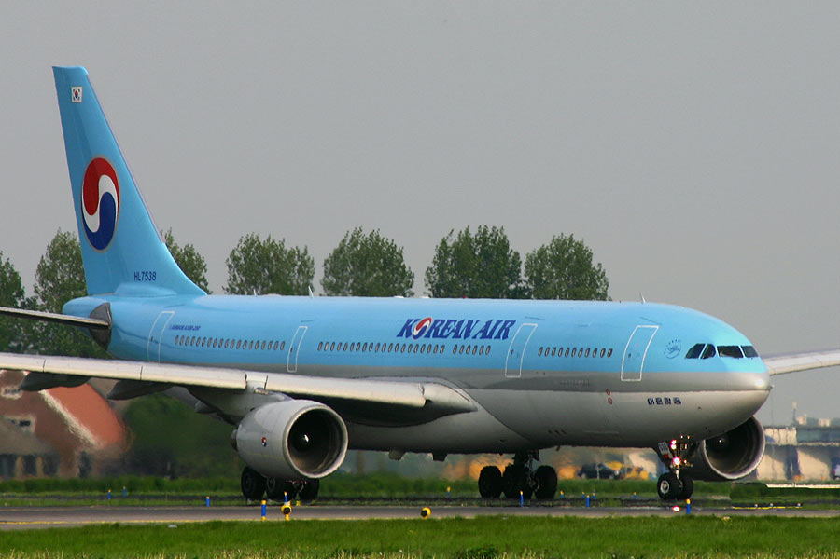
A T P - A e r o J O B T r a i n i n g Program
CREW RESOURCING SERVICES
CONTRACTED PARTNERS
A New Way to the Cockpit

Slide 46
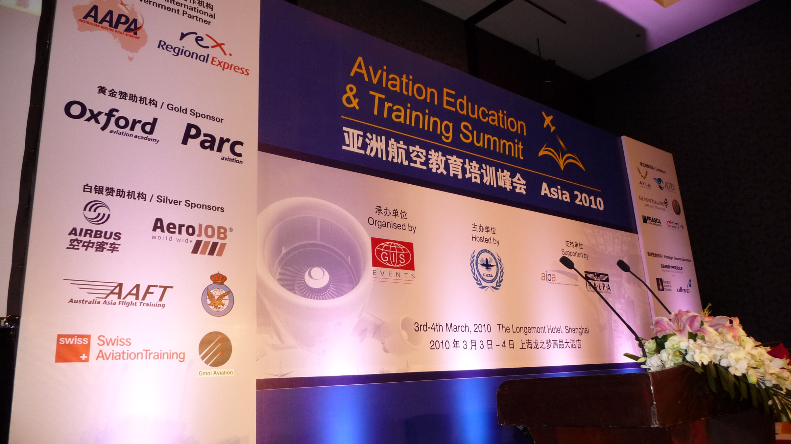
A T P - A e r o J O B T r a i n i n g Program
CREW RESOURCING SERVICES
Aviation Training Summit CHINA 2010

Slide 47
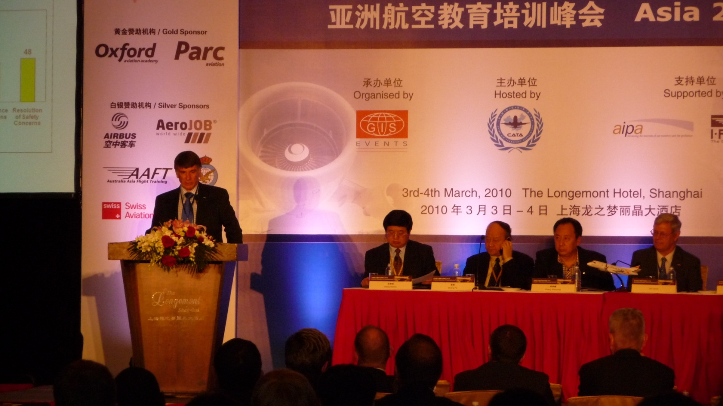
A T P - A e r o J O B T r a i n i n g Program
CREW RESOURCING SERVICES
Aviation Training Summit CHINA 2010

Slide 48
A T P - A e r o J O B T r a i n i n g Program
CREW RESOURCING SERVICES
UPSET RECOVERY TRAINING

Slide 49
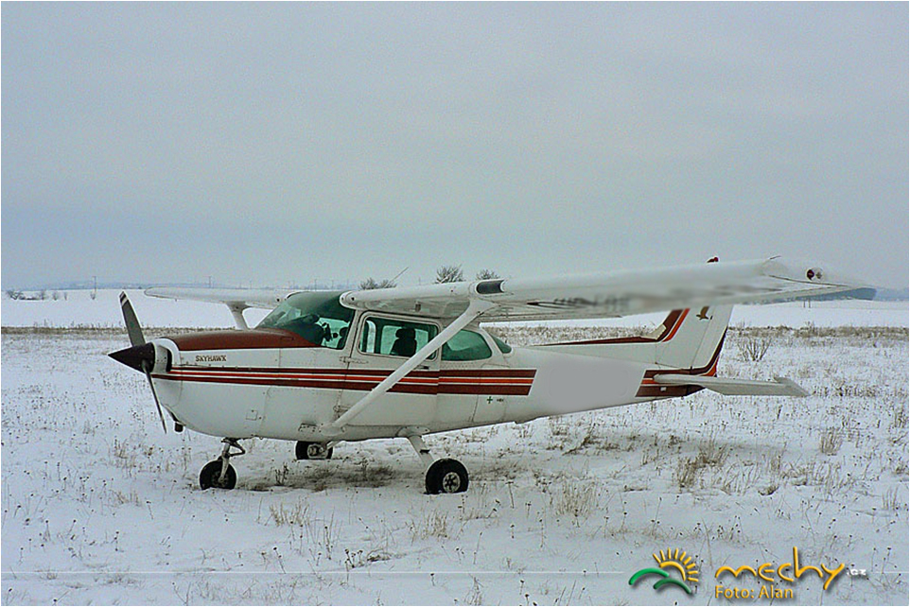
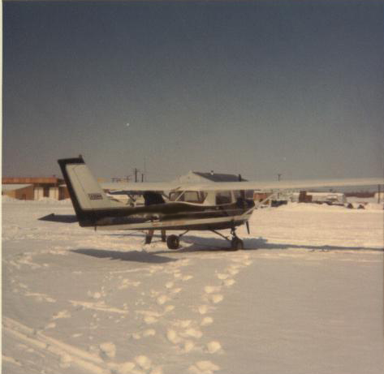
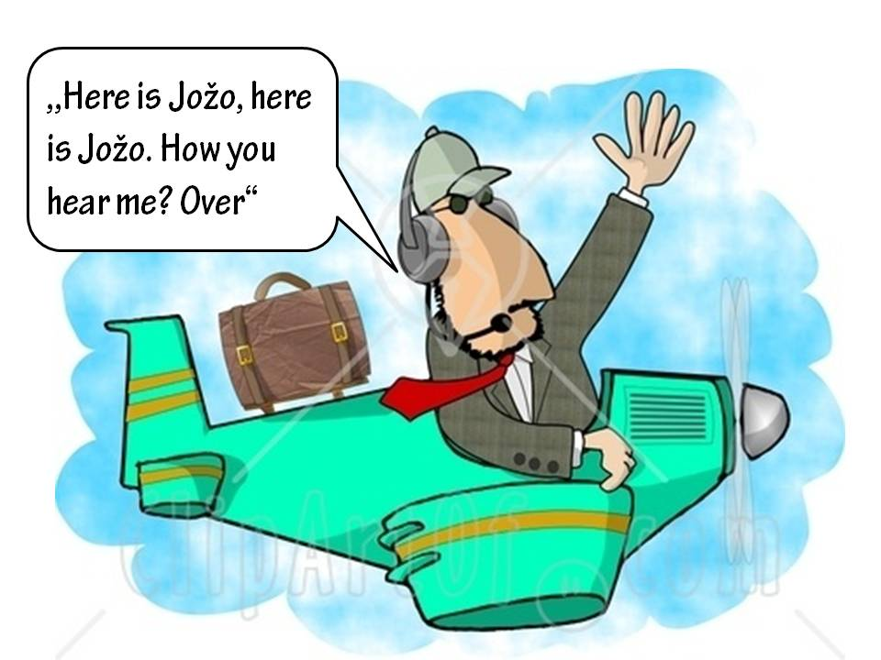
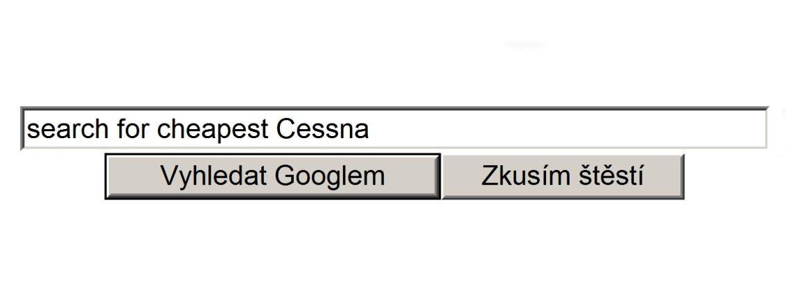
A T P - A e r o J O B T r a i n i n g Program
SUMMARY OF DIFFERENCES
ORDINARY FTO
- No Pre-Selection
- Insufficient textbooks
- Incomplete fleet
- focused for PPL training
- Basic Aviation English
- No funding training
- A Few module only
A New Way to the Cockpit

Slide 50
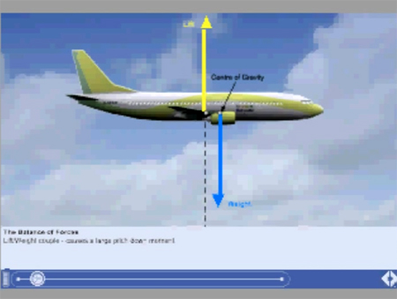
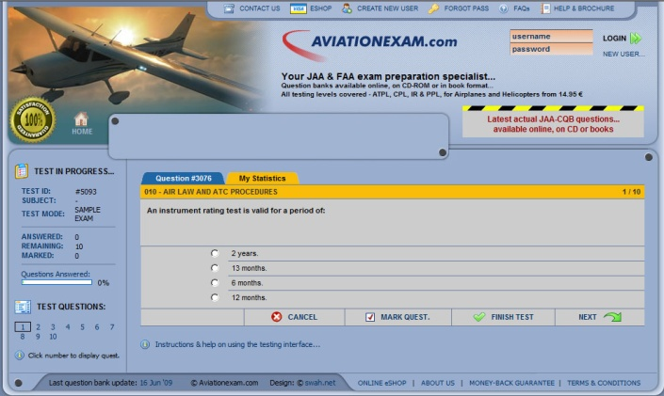
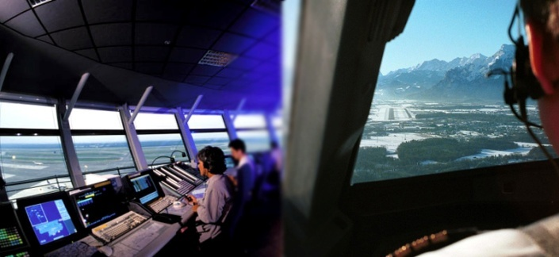
A T P - A e r o J O B T r a i n i n g Program
SUMMARY OF DIFFERENCES
ATP ATPL TRANING 1/2
- Pre-Selection
- Training in accordance with original
OXFORD AVIATION ACADEMY Program
- The highest standard Aviation English
- Modern CBT and e-learning/e-exam
- Testing and Progress Checks
- Funding of training
- Experienced lectors
- Additional ground lessons
A New Way to the Cockpit

Slide 51
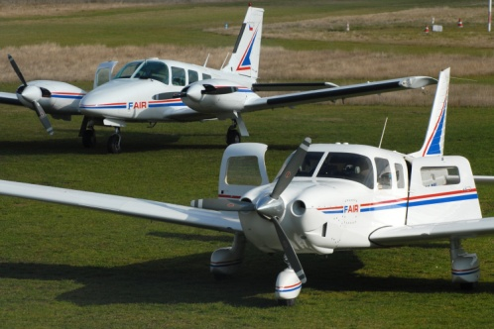
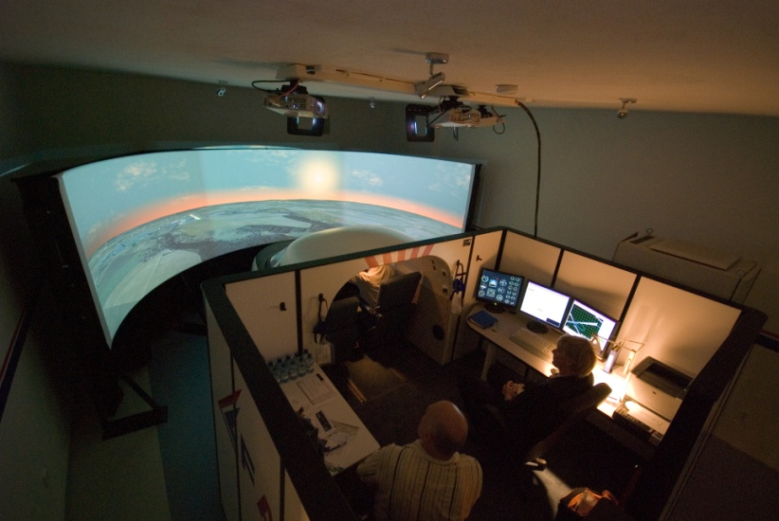
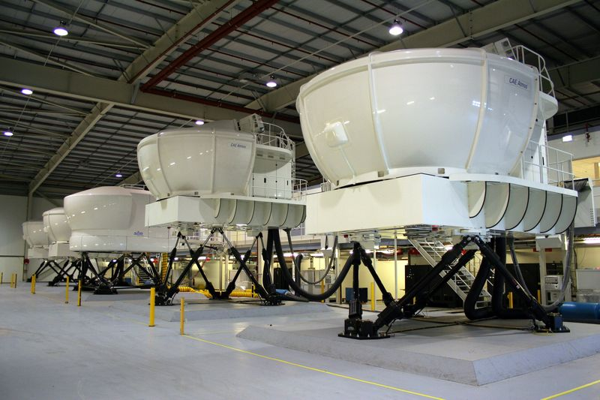
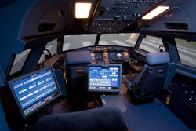
A T P - A e r o J O B T r a i n i n g Program
SUMMARY OF DIFFERENCES
ATP ATPL TRANING 2/2
- Type Rating
- New well equiped planes
- Simulator FNPT II MCC
A New Way to the Cockpit

Slide 52
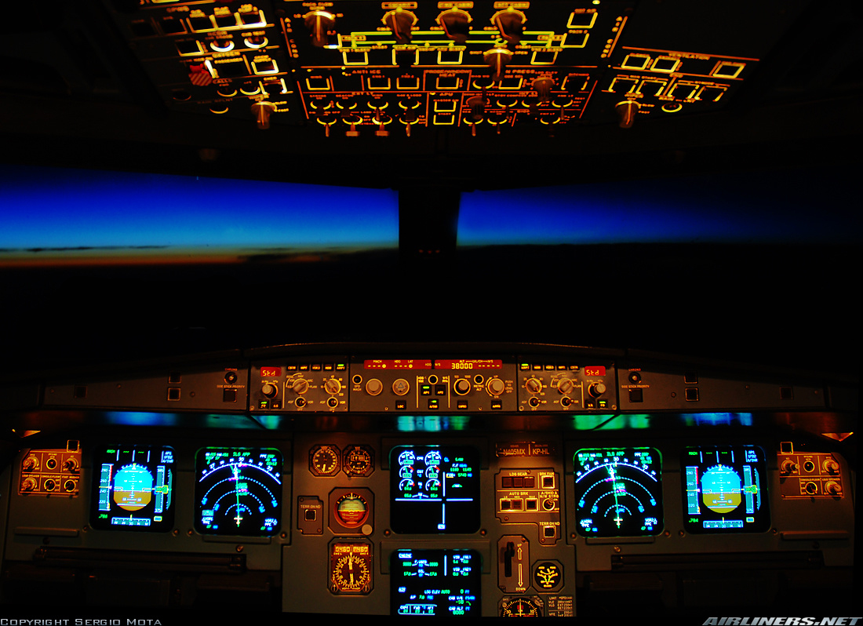
A T P - A e r o J O B T r a i n i n g Program
SUMMARY OF DIFFERENCES
WE RECEIVE FEEDBACK FROM OUR PARTNER AIRLINES
=
CONSTANTLY IMPROVING OUR TRAINING PROGRAMS
A New Way to the Cockpit

Slide 53
A T P - A e r o J O B T r a i n i n g Program
Unique Complex Airline Pilot Program
CANDIDATES PRE-SELECTION
HIGH STANDARDS TRAINING
TRAINING COST FUNDING
CREW RESOURCING SERVICES
A New Way to the Cockpit

Slide 54
APA - A e r o J O B Personnel Agency
ATP team thanks you for your time and attention . . .
New Way to the Cockpit

